Slide 1
Chapter 2
Data Manipulation

Slide 2
Chapter 2: Data Manipulation
2.1 Computer Architecture
2.2 Machine Language
2.3 Program Execution
2.4 Arithmetic/Logic Instructions
2.5 Communicating with Other Devices
2.6 Other Architectures
2-<number>
© 2005 Pearson Addison-Wesley. All rights reserved

Slide 3
Computer Architecture
Central Processing Unit (CPU) or processor
  Arithmetic/Logic Unit (ALU)
  Control Unit
  Registers
  Cache Memory
Bus
Motherboard
2-<number>
© 2005 Pearson Addison-Wesley. All rights reserved

Slide 4
Stored program concept
A program is just a special type of data.
  A program can be stored in main memory.
One general-purpose machine can run many different programs.
2-<number>
© 2005 Pearson Addison-Wesley. All rights reserved

Slide 5
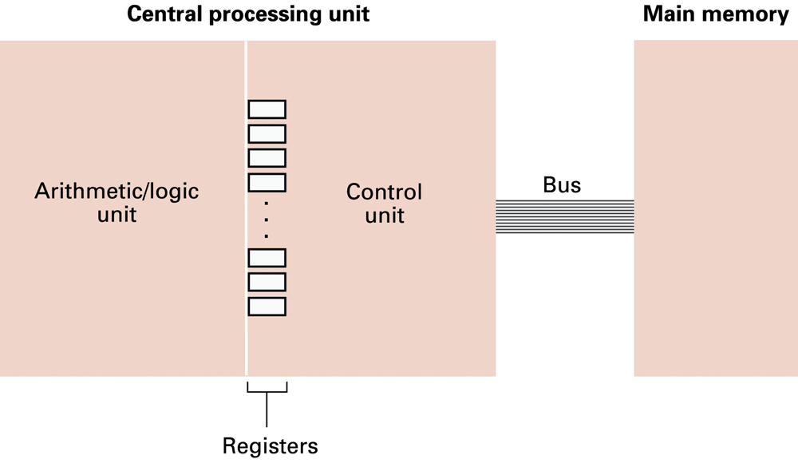
Figure 2.1 CPU and main memory connected via a bus
2-<number>
© 2005 Pearson Addison-Wesley. All rights reserved

Slide 6
Machine language: definitions
Machine instruction = an instruction coded as a bit pattern directly recognizable by the CPU
Machine language = the set of all instructions recognized by a machine
2-<number>
© 2005 Pearson Addison-Wesley. All rights reserved

Slide 7
Machine language philosophies
Reduced Instruction Set Computing (RISC)
  Few, simple, efficient, and fast instructions
  Example: PowerPC from Apple/IBM/Motorola
Complex Instruction Set Computing (CISC)
  Many, convenient, and powerful instructions
  Example: Pentium from Intel
2-<number>
© 2005 Pearson Addison-Wesley. All rights reserved

Slide 8
Machine instruction types
Data Transfer: copy data between CPU and main memory
Arithmetic/Logic: use existing data values to compute a new data value
Control: direct the execution of the program
2-<number>
© 2005 Pearson Addison-Wesley. All rights reserved

Slide 9
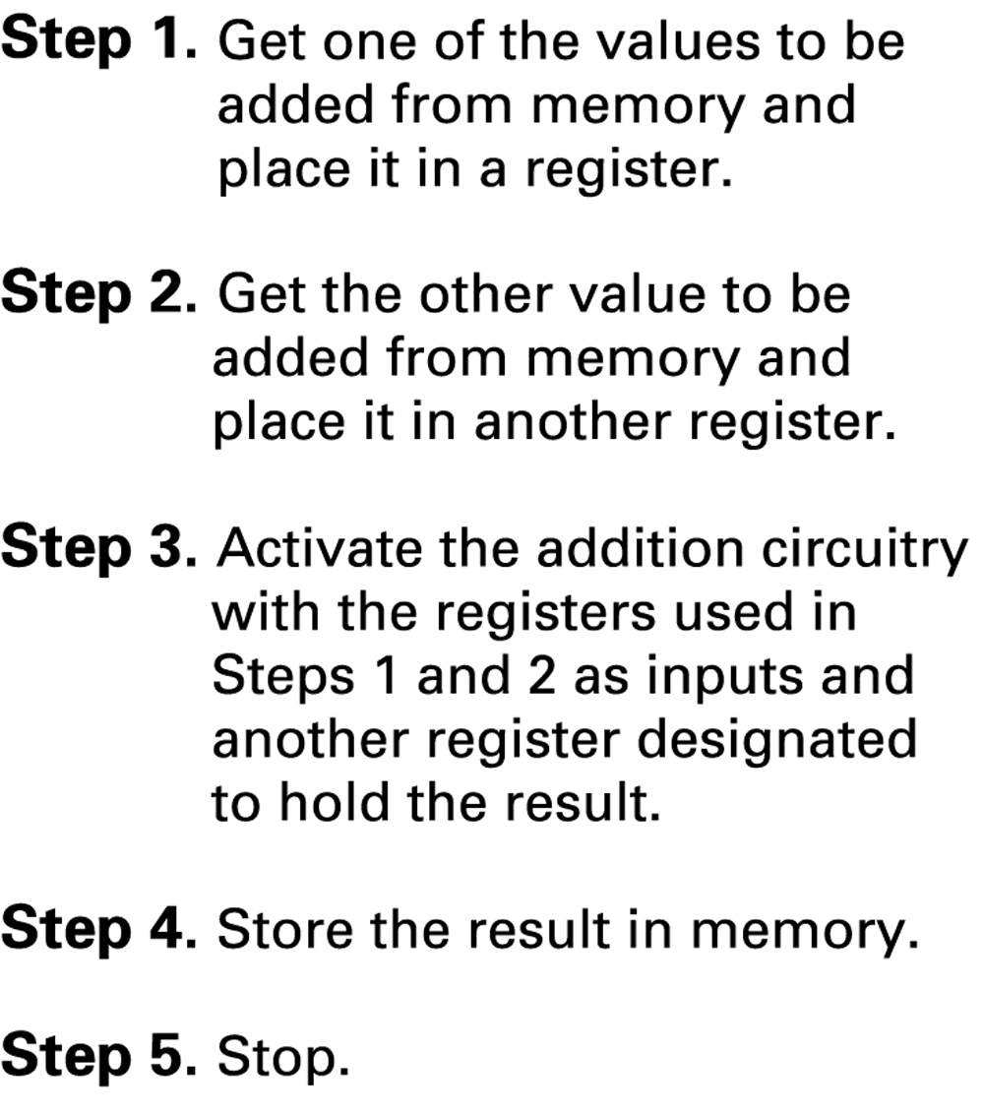
Figure 2.2 Adding values stored in memory
2-<number>
© 2005 Pearson Addison-Wesley. All rights reserved

Slide 10
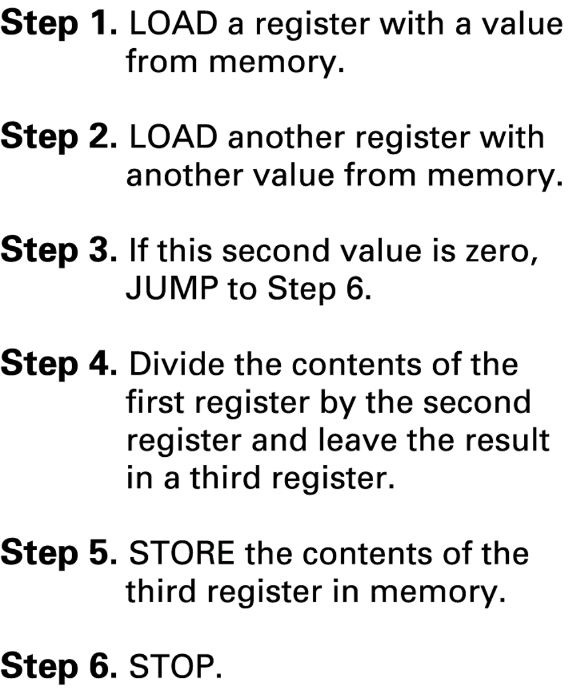
Figure 2.3 Dividing values stored in memory
2-<number>
© 2005 Pearson Addison-Wesley. All rights reserved

Slide 11
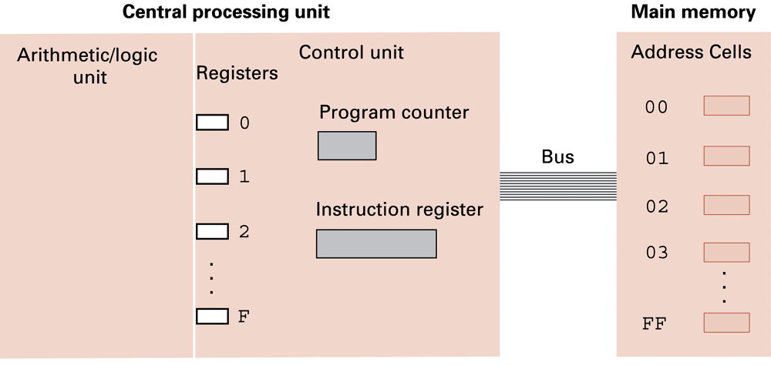
Figure 2.4 The architecture of the machine described in Appendix C
2-<number>
© 2005 Pearson Addison-Wesley. All rights reserved

Slide 12
Parts of a machine instruction
Op-code: specifies which machine operation to execute
  One per instruction
Operand: more detailed information about this operation
  Number of operands varies depending on op-code
  Interpretation of operand varies depend on op-code
2-<number>
© 2005 Pearson Addison-Wesley. All rights reserved

Slide 13
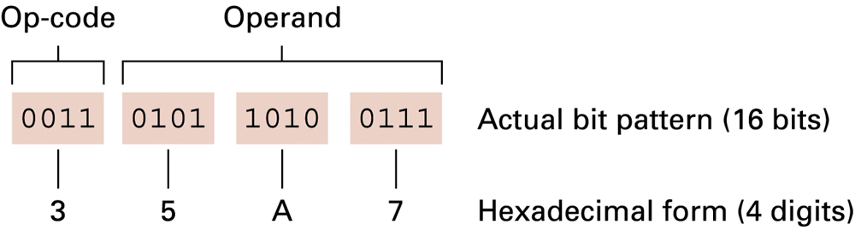
Figure 2.5 The composition of an instruction for the machine in Appendix C
2-<number>
© 2005 Pearson Addison-Wesley. All rights reserved

Slide 14
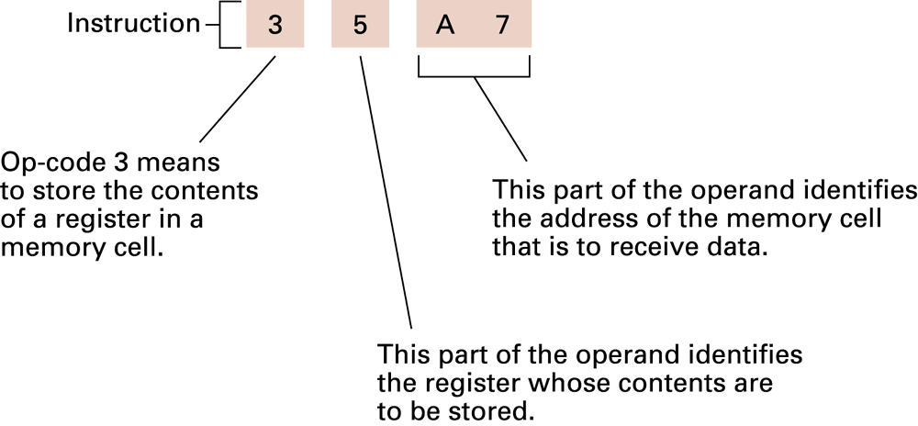
Figure 2.6 Decoding the instruction 35A7
2-<number>
© 2005 Pearson Addison-Wesley. All rights reserved

Slide 15
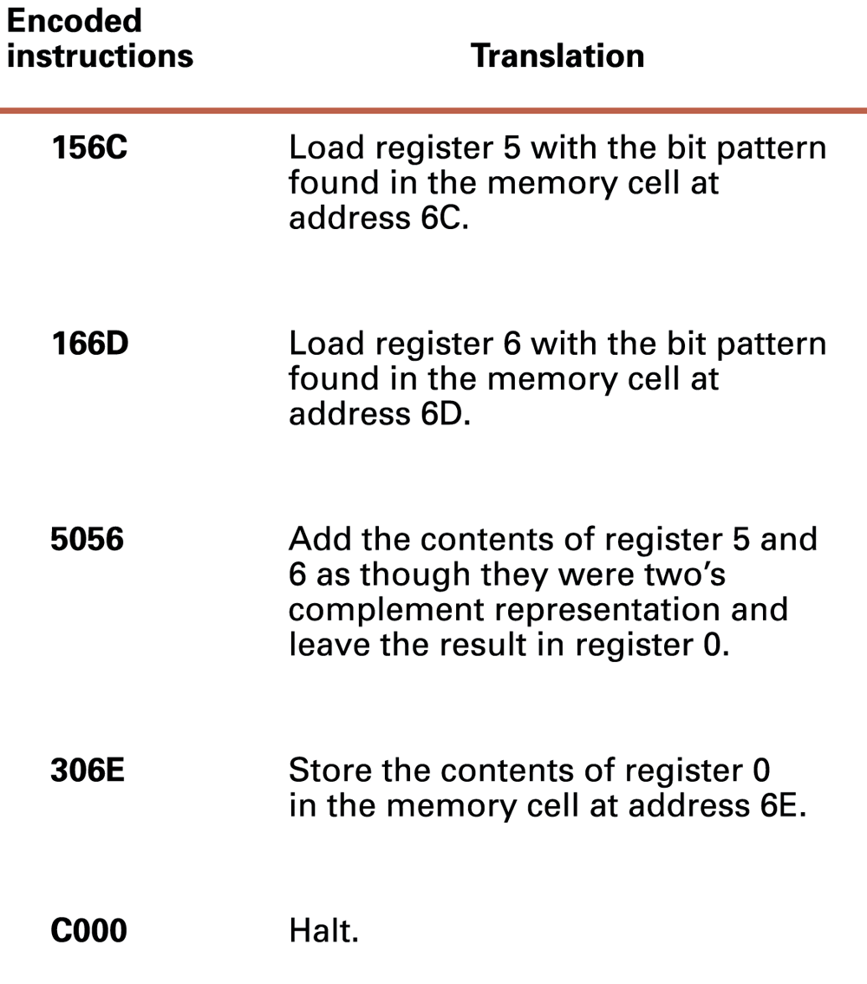
Figure 2.7 An encoded version of the instructions in Figure 2.2
2-<number>
© 2005 Pearson Addison-Wesley. All rights reserved

Slide 16
Program execution
Controlled by two special-purpose registers
  Program counter: address of next instruction
  Instruction register: current instruction
Steps performed by control unit
  Fetch
  Decode
  Execute
2-<number>
© 2005 Pearson Addison-Wesley. All rights reserved

Slide 17
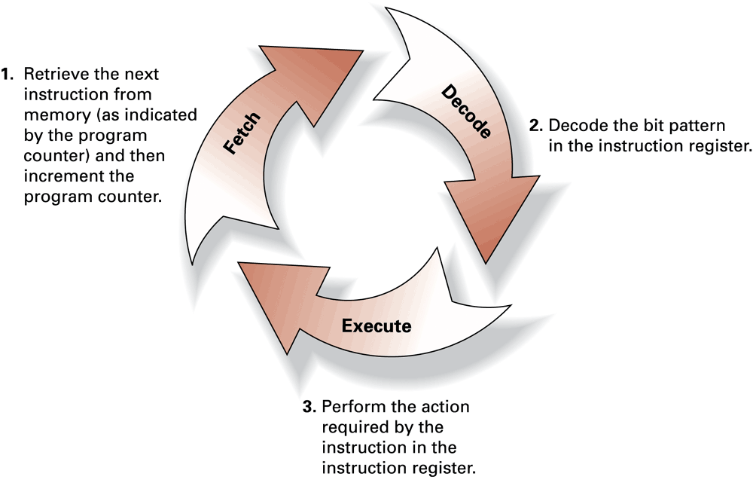
Figure 2.8 The machine cycle
2-<number>
© 2005 Pearson Addison-Wesley. All rights reserved

Slide 18
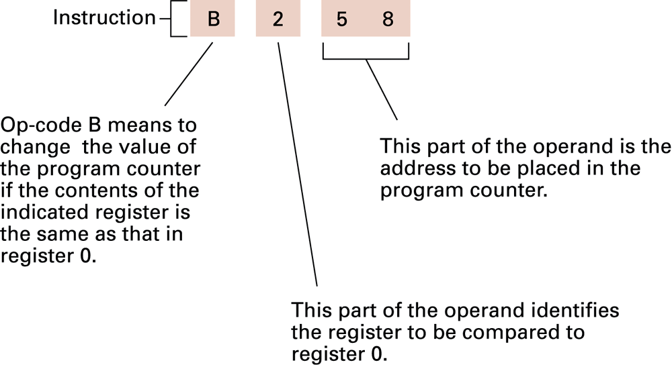
Figure 2.9 Decoding the instruction B258
2-<number>
© 2005 Pearson Addison-Wesley. All rights reserved

Slide 19
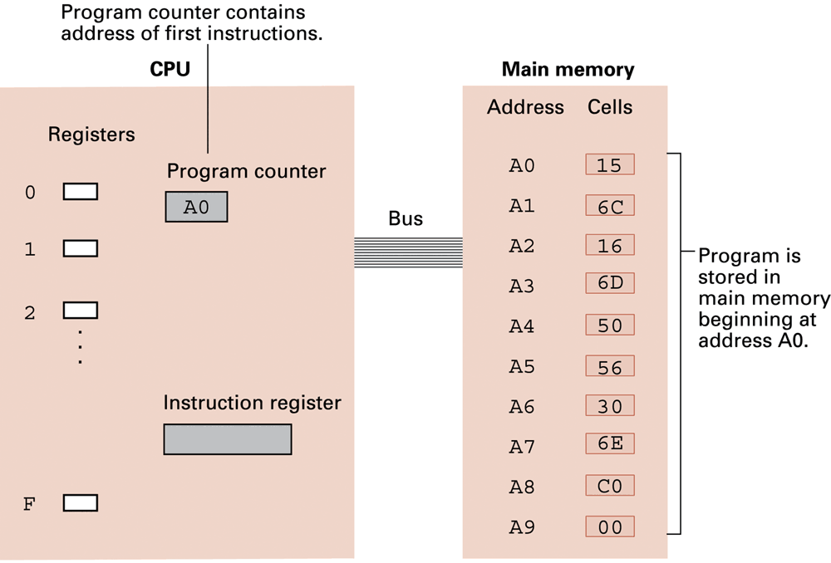
Figure 2.10 The program from Figure 2.7 stored in main memory ready for execution
2-<number>
© 2005 Pearson Addison-Wesley. All rights reserved

Slide 20
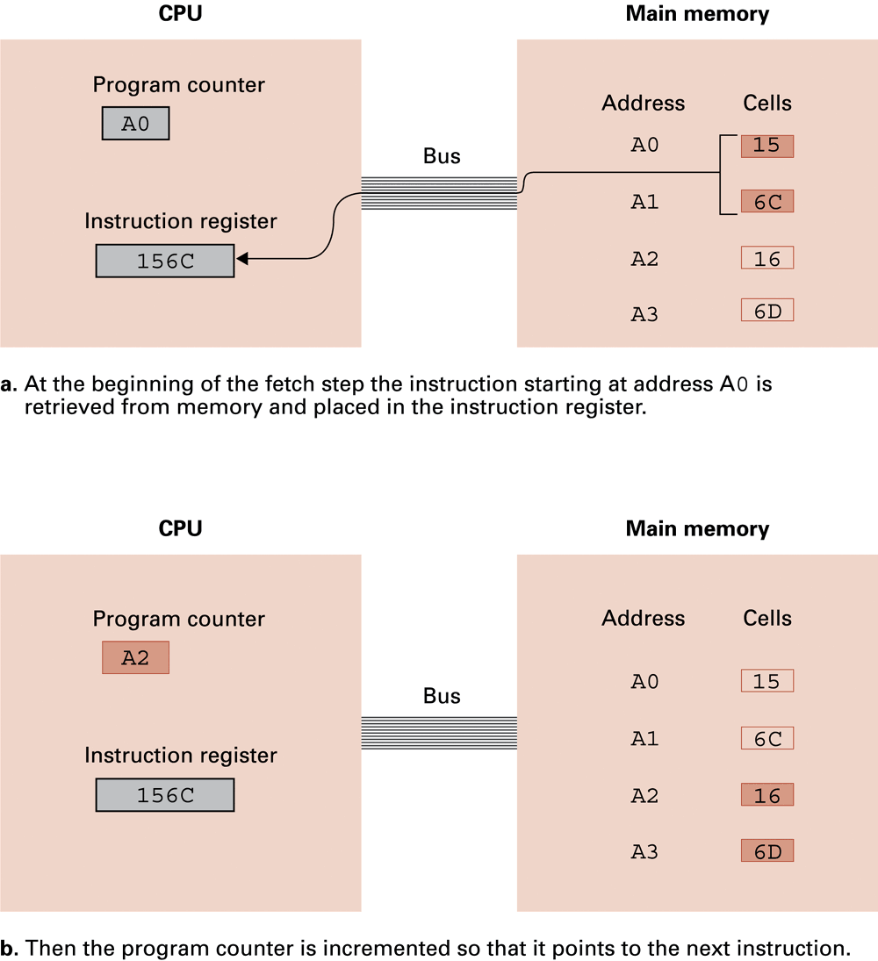
Figure 2.11 Performing the fetch step of the machine cycle
2-<number>
© 2005 Pearson Addison-Wesley. All rights reserved

Slide 21
Figure 2.11 Performing the fetch step of the machine cycle (cont’d)
2-<number>
© 2005 Pearson Addison-Wesley. All rights reserved

Slide 22
Arithmetic/Logic operations
Logic: AND, OR, XOR
  masking
Rotate and Shift: circular shift, logical shift, arithmetic shift
Arithmetic: add, subtract, multiply, divide
  Often separate instructions for different types of data
  Precise action depends on how the values are encoded (two’s complement versus floating-point).
2-<number>
© 2005 Pearson Addison-Wesley. All rights reserved

Slide 23
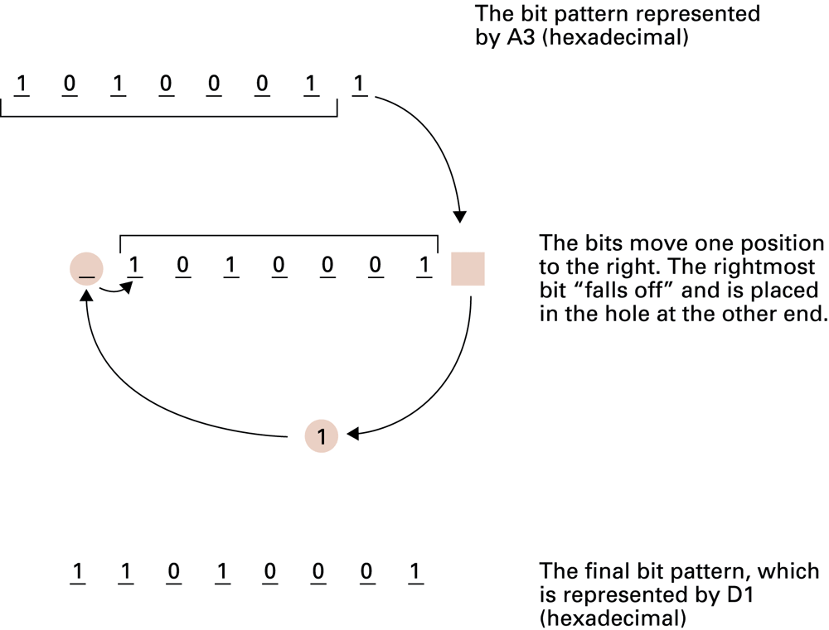
Figure 2.12 Rotating the bit pattern A3 one bit to the right
2-<number>
© 2005 Pearson Addison-Wesley. All rights reserved

Slide 24
Communicating with other devices
Controller = intermediary device that handles communication between the computer and a device.
Port = set of addresses assigned to a device.
  The point at which a device connects to a computer
  Memory-mapped I/O: CPU reads from or writes to addresses of the controller’s port
2-<number>
© 2005 Pearson Addison-Wesley. All rights reserved

Slide 25
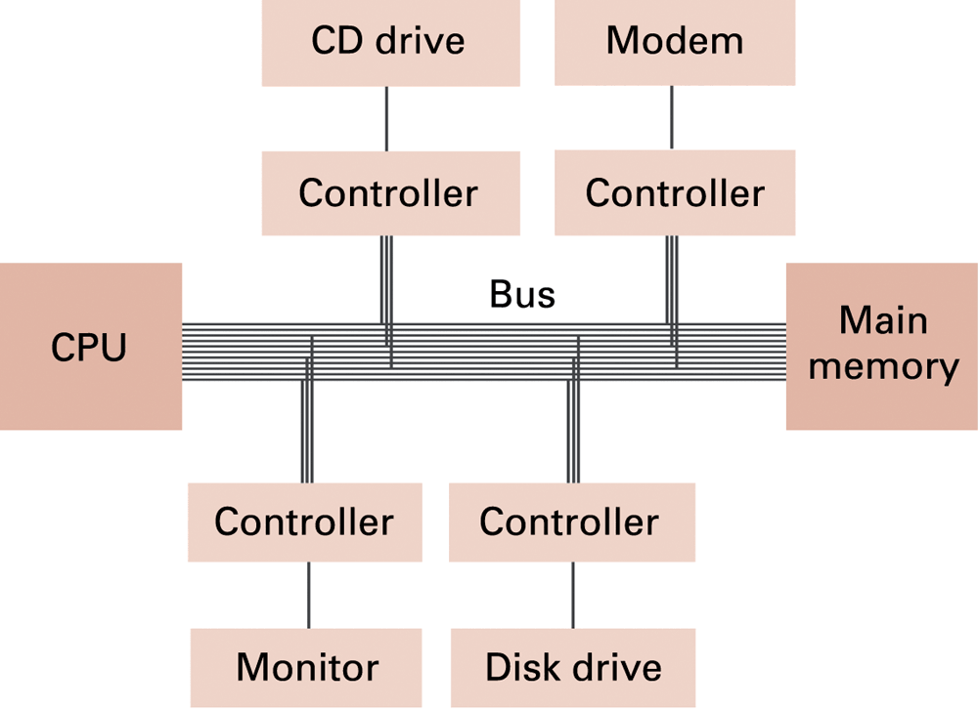
Figure 2.13 Controllers attached to a machine’s bus
2-<number>
© 2005 Pearson Addison-Wesley. All rights reserved

Slide 26
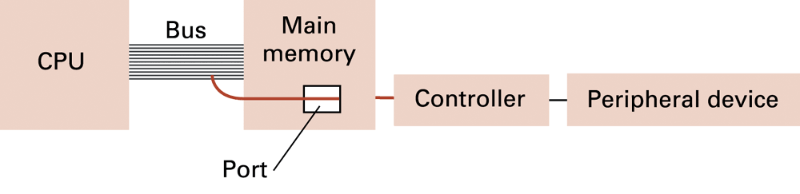
Figure 2.14 A conceptual representation of memory-mapped I/O
2-<number>
© 2005 Pearson Addison-Wesley. All rights reserved

Slide 27
Communicating with other devices (continued)
Direct memory access (DMA): main memory access by a controller over the bus
Von Neumann Bottleneck: insufficient bus speed impedes performance
Handshaking: the process of controlling the transfer of data between components of different speeds
(The process of coordinating the transfer of data between components)
Parallel communication several communication bits simultaneously
Serial communication bits are transferred one after the other over a single communication path.
2-<number>
© 2005 Pearson Addison-Wesley. All rights reserved

Slide 28
Data communication rates
Measurement units
  Bps = bits per second
  Kbps = kilo-bps, or 1,000 bps
  Mbps = mega-bps, or 1,000,000 bps
  Gbps = giga-bps, or 1,000,000,000 bps
Bandwidth = maximum available rate
2-<number>
© 2005 Pearson Addison-Wesley. All rights reserved

Slide 29
Data communication path types
Serial: one line transfers one bit at a time
Parallel: several lines transfer different bits simultaneously
Modem: converts between digital bits and analog tones
2-<number>
© 2005 Pearson Addison-Wesley. All rights reserved

Slide 30
Other architectures
Throughput = (total work) / (total time)
Technologies to increase throughput
  Pipelining: overlap steps of the machine cycle
  Parallel processing: use multiple processors simultaneously
    SISD = no parallel processing
    MIMD = different programs, different data
    SIMD = same program, different data
2-<number>
© 2005 Pearson Addison-Wesley. All rights reserved

